Slide 1

MPS in a nutshell
Tim Kräuter – 17/02/21

Slide 2
Agenda
Key information about MPS
Running example: Families and Persons
Defining the abstract syntax / the metamodel
Adding constraints?
Developing the concrete syntax
Implementing model transformations

Slide 3
https://github.com/timKraeuter/PCS955-DAT355

Slide 4

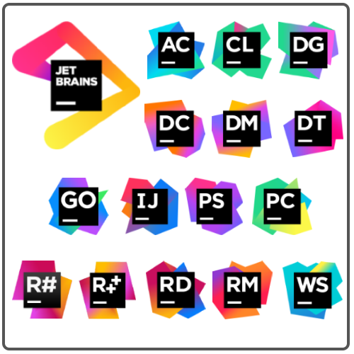

Key information about
Language Workbench to create DSL`s, which means:
Defining the abstract syntax of a language (= metamodel)
Adding constraints to the abstract syntax / the metamodel
Develop concrete syntax
Implement model transformations
Developed by:
Notes:
JetBrains is a Czech software development company Sry this slide looks like I get payed by Jetbrains. I do not.

Slide 5
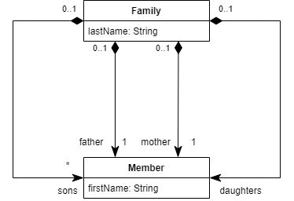
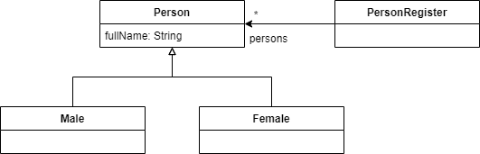
Running example: Families and Persons
Families metamodel:
Persons metamodel:
Adapted from: https://wiki.eclipse.org/ATL/Tutorials_-_Create_a_simple_ATL_transformation
Notes:
This is example is to showcase MPS and not to create a useful DSL.

Slide 6
Defining the abstract syntax / the metamodel
The definition of the metamodel is done by defining concepts in MPS.
Let us define the families metamodel together
You can find the end result here.

Slide 7
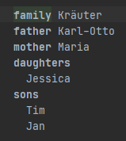
Developing the concrete syntax
Developing the concrete syntax is done by defining editors in MPS.
Let us define a simple textual syntax now and create a family (a model) by using it.
You can find the end result here.

Slide 8
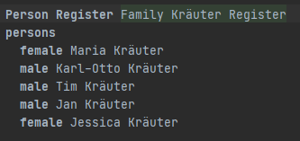
Implementing model transformations
conforms to
But how?
conforms to
MPS Generator
Notes:
Just show this part in MPS dont program it live.

Slide 9
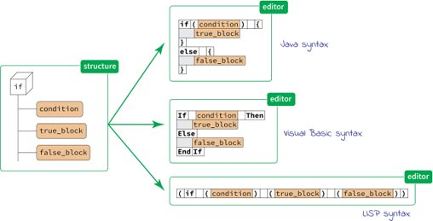
Conclusion
The projectional editor is really interesting!
Working on the abstract syntax tree will make you fluctuate between euphoria and depression!
Very good documentation and stable DIE
There is a lot more to learn about MPS!
→ You cannot jump right into MPS without doing any tutorial
Notes:
User dont want to install MPS and can definetly not work on the AST! In general, very streamlined really nice tutorial and documentations. No weird bugs encountered! Things more to learn: - Projectional editor with graphical stuff
- Projection editor with mixes of graphs, tables and texts. - More detailed and complex DSL and model transformations - Looking at the trace model etc.

